Slide 1

Tutorial
Introduction to Retrieval Augmented Generation (RAG)
Bruce Kyle
Solution Architect and Platform Engineering Team
IBM Client Engineering

Slide 2


Introduction to Retrieval Augmented Generation (RAG) IBM Client Engineering
Bruce Kyle
Solution Architect and Platform Engineering Team
May 27, 2025

Slide 3
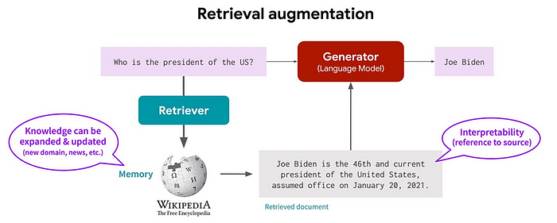
Why not just use prompts?
Notes:
Illustration from Overcoming RAG Challenges: Common Pitfalls and How to Avoid Them Introduction | by Raghav | Medium
https://medium.com/@raghav_47115/overcoming-rag-challenges-common-pitfalls-and-how-to-avoid-them-introduction-23de0637e11f

Slide 4
Why RAG?
Helps solve several challenges in natural language processing (NLP) and AI applications:
Factual Inaccuracies and Hallucinations
Outdated Information
Contextual Relevance
Domain-Specific Knowledge
Cost and Efficiency.
Scalability Across Domains
Notes:
The retrieval-augmented generation (RAG) approach helps solve several challenges in natural language processing (NLP) and AI applications:
Factual Inaccuracies and Hallucinations: Traditional generative models can produce plausible but incorrect information. RAG reduces this risk by retrieving verified, external data to ground responses in factual knowledge.
Outdated Information: Static models rely on training data that may become obsolete. RAG dynamically retrieves up-to-date information, ensuring relevance and accuracy in real-time.
Contextual Relevance: Generative models often struggle with maintaining context in complex or multi-turn conversations. RAG retrieves relevant documents to enrich the context, improving coherence and relevance.
Domain-Specific Knowledge: Generic models may lack expertise in specialized fields. RAG integrates domain-specific external knowledge for tailored and precise responses.
Cost and Efficiency: Fine-tuning large models for specific tasks is expensive. RAG eliminates the need for retraining by dynamically retrieving relevant data, reducing costs and computational load.
Scalability Across Domains: RAG is adaptable to diverse industries, from healthcare to finance, without extensive retraining, making it highly scalable

Slide 5
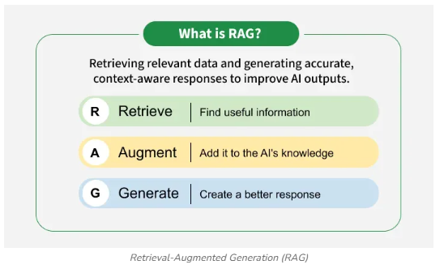
What is RAG?
Notes:
From What is Retrieval-Augmented Generation (RAG) ? | GeeksforGeeks

Slide 6






Use cases for RAG
Advanced Question-Answering System
Content Creation and Summarization
Conversational Agents and Chatbots
Information Retrieval
Educational Tools and Resources
Verify Source of Truth

Slide 7
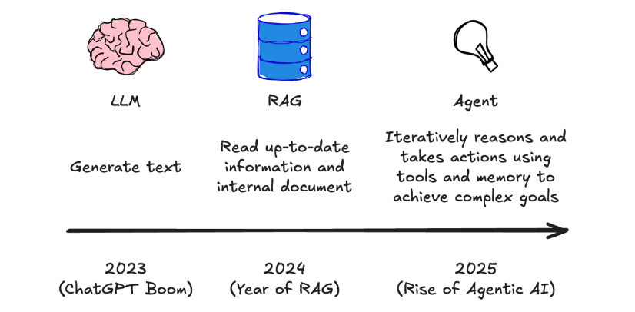
From LLM to RAG to Agentic AI
Notes:
From https://ibm.seismic.com/Link/Content/DC4DF9Gb2HbqfGFDTb8Hh3c2HqqP

Slide 8
When to use what in GenAI
The best method depends on your specific requirements:
Use Prompt Engineering if you need a quick and simple solution for specific tasks or queries.
Use RAG if you need to enhance your model's responses with real-time, relevant information from external sources.
Use Fine-tuning if you have domain-specific data and want to improve the model's performance on specific tasks.
Use Pretraining if you need a strong foundation for further customization and adaptation.
Use AgenticAI when tasks are complex, require real-time adaptation, and need to be executed efficiently without constant human oversight.

Slide 9

How does it work?

Slide 10
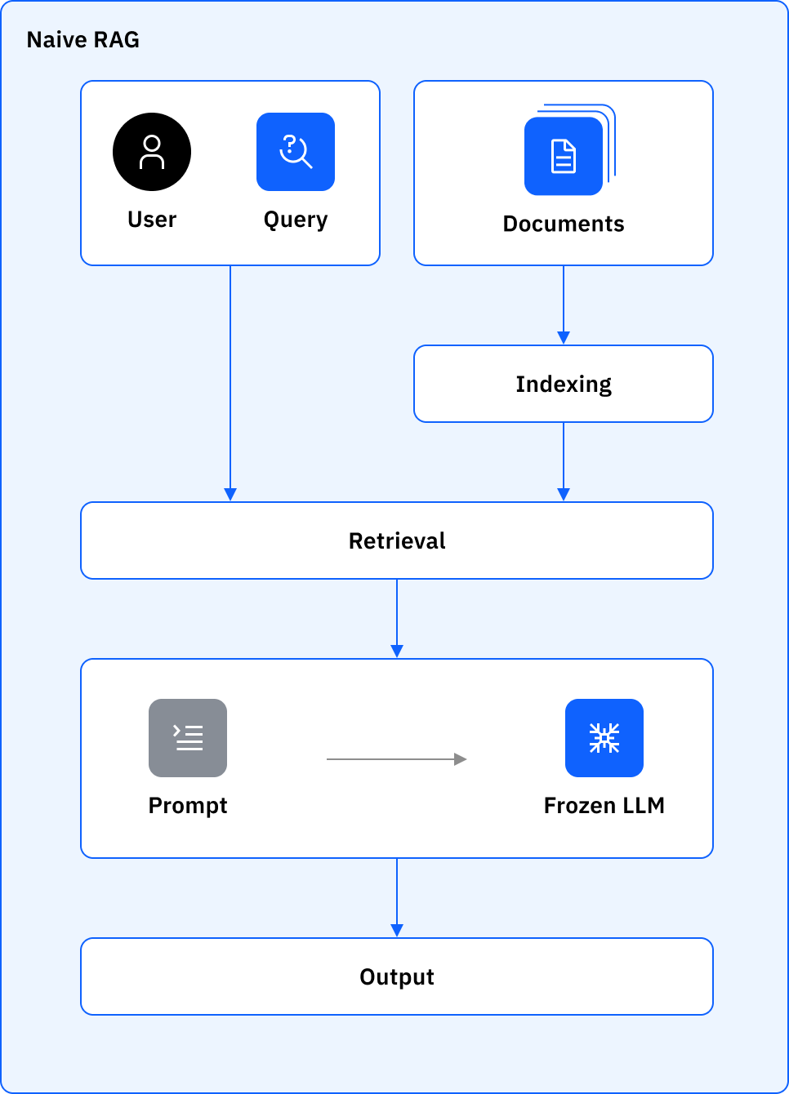
How does RAG work?
Three-step process (encoding, retrieval and response generation) of how naive RAG works.
Notes:
https://www.ibm.com/think/topics/rag-techniques
From Fig 1 illustrates the three-step process (encoding, retrieval and response generation) of how naive RAG works.
Naive RAG relies on a rather straightforward three-step process for retrieval and content generation. The following steps explain how the retrieval process works:
Query encoding: The query made by the user is transformed into a high-dimensional vector by using an embedding model, capturing the semantic meaning of the entire query.
Document retrieval: A similarity search is performed by using this vector against repositories through vector databases retrieving the top-N documents relevant to the query. The knowledge base can be constructed from structured and unstructured data sources, such as open source datasets or enterprise datasets.
Response generation: The retrieved data sources are then served as additional context into a language model that synthesizes a coherent and informative response grounded in external knowledge ^{3, 4}.
Applications of naive RAG
Naive RAG is best suited to scenarios where simplicity, speed and ease of deployment are paramount over advanced accuracy and flexibility. The simplicity of the architecture makes it ideal for building proof-of-concept applications and enabling fast testing of ideas without the burden of cumbersome model adjustments. For example, it can be effectively used in:
a. Customer support chatbots: Handling frequently asked repetitive question-answering scenarios by using LLM responses.
b. Summarization and information retrieval: Providing a basic level of summarization by using natural language processing techniques.
c. AI systems for enterprises: Quickly retrieving relevant data from repositories to answer common queries.

Slide 11
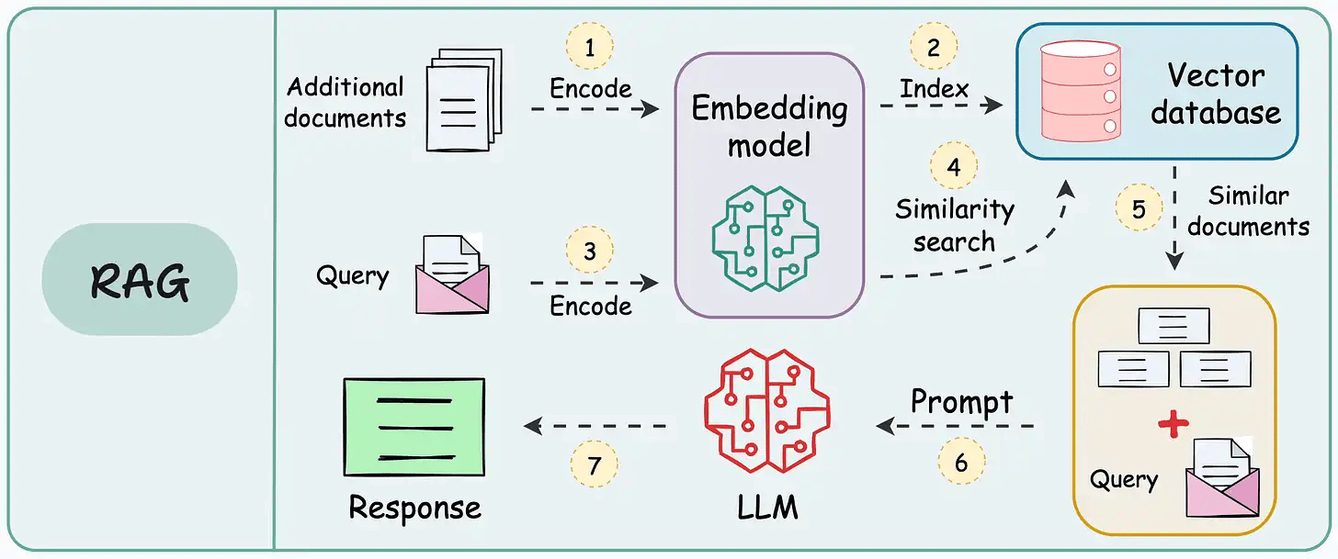
Notes:
Slightly more technical way to view this

Slide 12
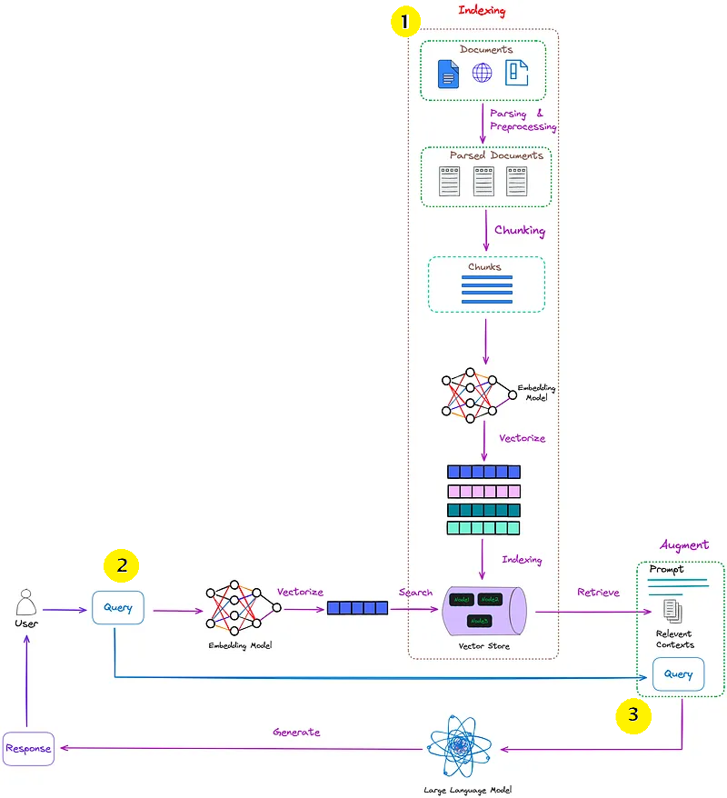
Tutorial
Enterprises often have vast amounts of internal documentation, reports, and knowledge bases that are difficult for employees to quickly search and synthesize information from. This leads to wasted time, reduced productivity, and inconsistent answers to common questions.
A **Retrieval Augmented Generation (RAG)** system can address this by providing a natural language interface to access and summarize information from these internal documents.
You will see how to set up your RAG:
1. Embedding of a set of documents and storing the vectors in a Chroma vector database
2. When a user enters a query, the application converts the query into an embedding and retrieves the most relevant text chunks from the index.
3. Once it finds the relevant passages, the LLM will generate an appropriate answer based on the content in the documents you provided.
Notes:
Image from: Advanced RAG 01: Problems of Naive RAG | by Florian June | Artificial Intelligence in Plain English https://ai.plainenglish.io/advanced-rag-part-01-problems-of-naive-rag-7e5f8ebb68d5

Slide 13
Common issues with RAG (Retrieval-Augmented Generation)
Retrieval quality issues
Integration challenges
Scalability concerns
Ethical considerations
Limited training data
Domain knowledge gaps
Factual inconsistencies

Slide 14


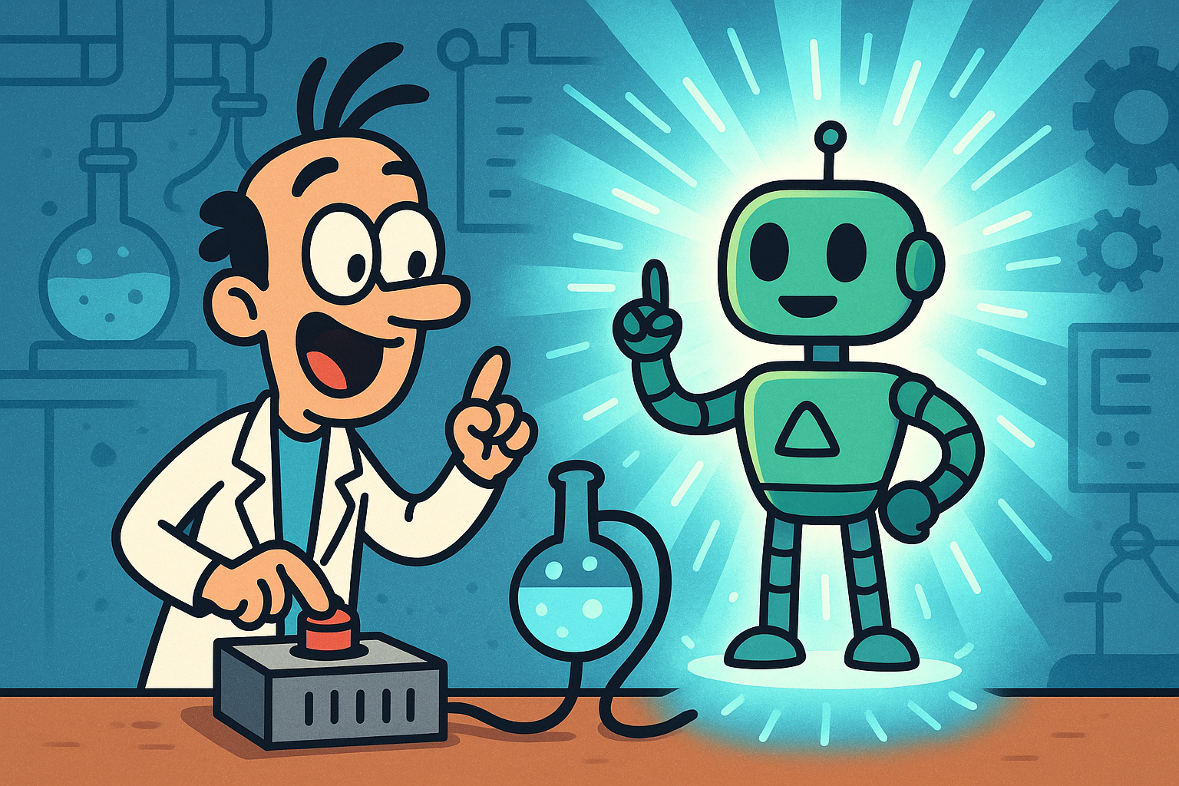
Next steps
Parsing of multiple document formats incl. PDF, DOCX, XLSX, HTML, images, and more
Advanced PDF understanding incl. page layout, reading order, table structure, code, formulas, image classification, and more
Extract data from text, from pictures, build queries of databases, generate graphs and charts to express data in new ways
Agentic AI. Where the AI can decide which “agents/prompts” to call to solve a user inquiry and act on that decision

